Slide 1
Women Empowerment

Slide 2



TEAM MEMBERS:
Shreyanshu Malviya
Jayant Arya
Rama Krishna Kasagani
Nidhish Bisht
Debarya Pal

Slide 3

INTRODUCTION:
Provides NGOs and Women a common platform.
Provides safe and conveniently located accommodation for working women.
Trains the Women and make them ready for Job.
Helps women to find the best accommodation for them.
With NGOs provide a wide range, variety of courses.

Slide 4

INTRODUCTION TO STEP:
b) To provide skills that enable women to become self-employed/entrepreneurs.
STEP: Support to Training and Employment Program for Women.
Objectives:
NGO provide Training and Employment Program.
Interested women should register in courses provided by NGO.
a) To provide skills that give employability to women.

Slide 5

INTRODUCTION TO SUKANYA SAMRIDDHI YOJANA:
Saving scheme for Parents of Girl Child.
Part of the ‘Beti-Bachao-Beti-Padhao’ campaign.
Only one account can be opened in the name of a girl child.
Parent need to fill registration form with proper documents.
Registration forms goes for validation to admin and then to the post offices/Authorized banks.

Slide 6
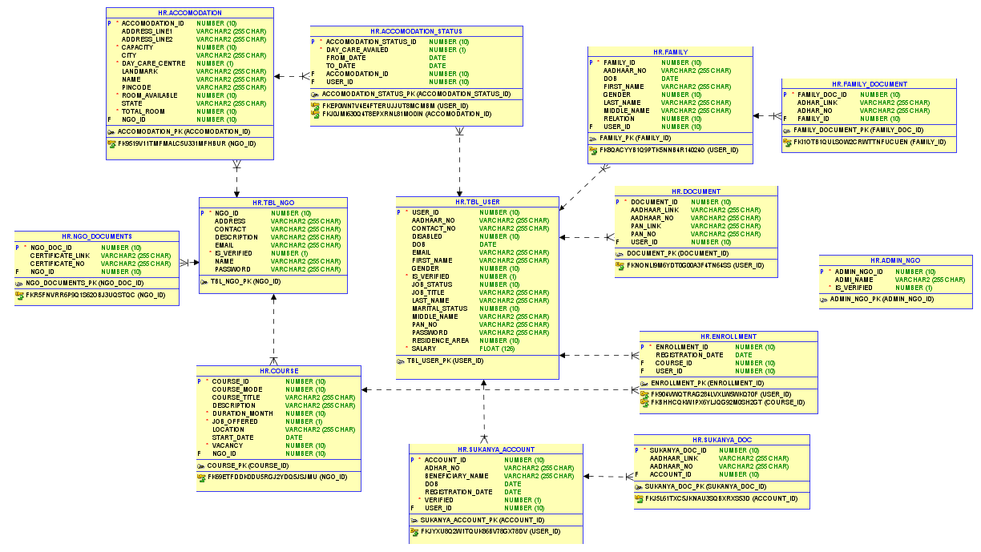

Slide 7
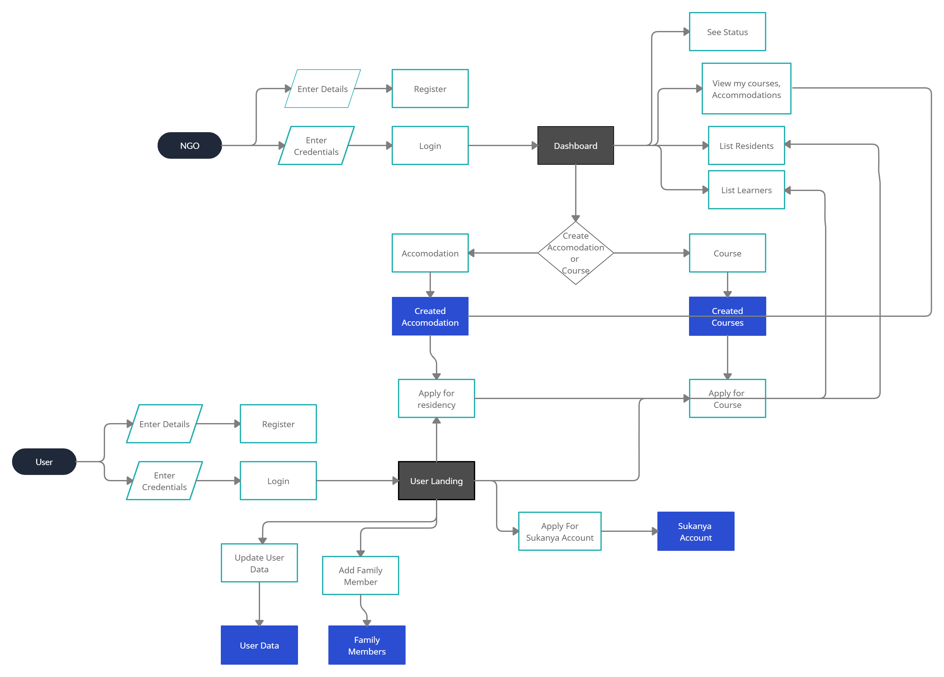
EXECUTION FLOW:

Slide 8
AGILE METHODOLOGY:
Identified the User Stories.
Divided User Stories into two Sprints.
Assigned User Stories to team members.
Incorporated feedback and suggestions from our Trainer.
Daily Stand Up meets for progress tracking.
Regular team meetings for planning, conflict resolutions and integrations.

Slide 9
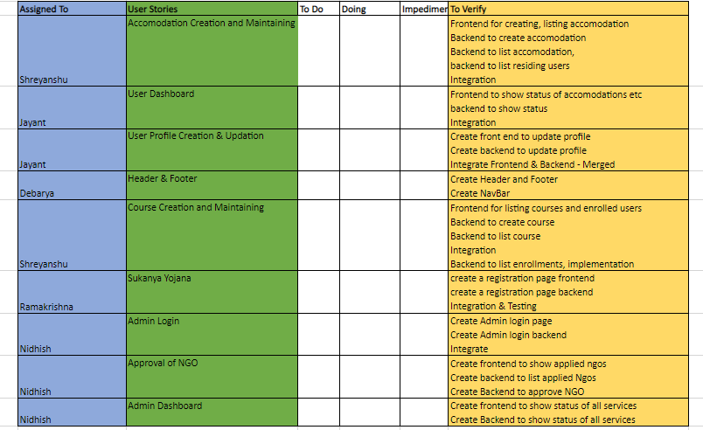
SPRINT-1 SCRUM BOARD:

Slide 10
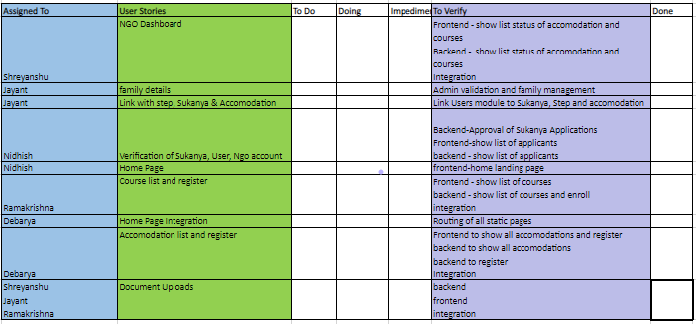
SPRINT-2 SCRUM BOARD:

Slide 11



FRONT END TECHNOLOGIES:

Slide 12




BACK END TECHNOLOGIES:

Slide 13




DEVOPS AND TESTING TOOLS:

Slide 14


IDEs USED:

